Slide 1
Speech recognition using THE hidden markov model
By: Nicole Cappella

Slide 2
Why I chose Speech Recognition
Always interested me
Dr. Phil Show
Manti Teo Girlfriend Hoax
Three separate voice analysts proved Roniaha was girlfriends voice

Slide 3
Roadmap
What is Speech Recognition?
Voice Recognition?
Process from Speech Production to Speech Perception
How Speech is Represented
Models of Speech Recognition
Types of Speech Recognition
Hidden Markov Model
Why HMM used in Speech Recognition
Three Basic Problems of HMM

Slide 4
Voice Recognition
Aimed towards identifying the person who is speaking
How it works
Every individual has unique pattern of speech due to their anatomy and behavioral patterns
Speaker verification vs. Speaker identification

Slide 5
Speech Recognition
Also known as Automatic Speech Recognition or Computer Speech Recognition
Translation of spoken words into text
Speaker Independent
Speaker Dependent
Performance of speech:
Accuracy
Speed
Problem?

Slide 6
Speech Recognition Applications:
Voice User Interfaces
Call Routing
Domestic Appliance Control
Search
Simple Data Entry
Radiology Report
Speech-to-text Processing
Aircrafts

Slide 7
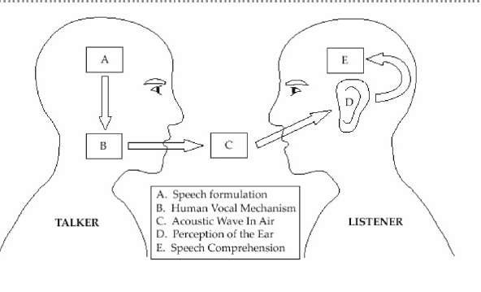
Diagram of the Speech Production/Perception Process

Slide 8
Speech Representation
Speech signal represented in two different domains: time and the frequency domain
Three speech representations:
Able to use speech signal and interpret its characteristics
Three-state Representation
Spectral Representation
Parameterization of the Spectral Activity
Useful to label the speech waveform being analyzed in a linguistic sense

Slide 9
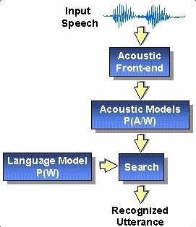
Basic Model of Speech Recognition
This is a diagram of the recognition process
Standard Approach
P(W,Y)
Goal:
Decode string

Slide 10
Types of Speech Recognition
Different classes based on types of utterances they are able to recognize
1. Isolated Words
“Listen/Not-Listen” states
2. Connected Words
“run-together”
3. Continuous Speech
Natural speech
4. Spontaneous Speech
“ums”, “ahs”, stutter

Slide 11
Approaches to Speech Recognition
3 different approaches:
1. Acoustic Phonetic Approach
2. Pattern Recognition Approach
HMM
3. Artificial Intelligence Approach

Slide 12
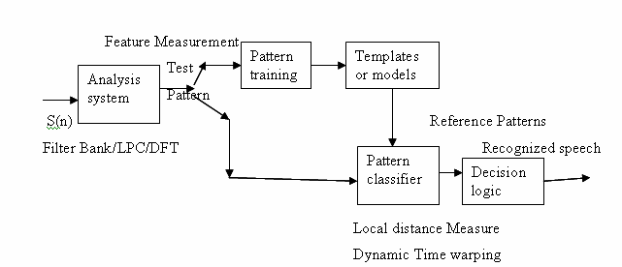
Pattern Recognition Approach
2 steps:
Pattern Training
Pattern Comparison
Uses mathematical framework
Forms:
Speech Template
Statistical Model (HMM)
Goal to determine identity of unknown speech according to how well patterns match

Slide 13
Methods in Pattern Comparison Approach
Template Based Approach
Patterns stored as dictionary of words
Match unknown utterance with reference templates
Select best matching pattern
Stochastic Approach (HMM)
Probabilistic Models
Uncertainty and Incompleteness

Slide 14
HMM
HMM is used in the technique to implement speech recognition systems
Characterized by finite state Markov Model and set of output distributions
Doubly stochastic
Underlying stochastic process which is not observable

Slide 15
The “Hidden” Part of the Model
System being modeled is assumed to be a Markov process with unobserved states
States not visible
output is visible
Each state has probability distribution
Hidden refers to the state sequence through which model passes

Slide 16
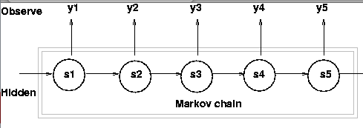

Diagram and Representation of HMM
-Three Probability Densities
-Least important
-Most important

Slide 17
Why HMM’s Used in Speech Recognition
General purpose speech recognition systems are based on HMM
Used because speech signal can be viewed as:
a piecewise stationary signal
short-time stationary signal
Can be trained automatically
Simple
Computationally feasible

Slide 18
Problems with HMM
Three problems
1. Evaluation Problem
How do we “score” or evaluate the model?
2. Estimation Problem
How do we uncover state sequence?
3. Training Problem
It adapts the model parameters to observed training data → will create the best models for real phenomena

Slide 19
How Solutions to HMM Problems select word:
Example:
How use Problem 3 ( Training Problem)
Get model parameters for each word model
How use Problem 2 ( Estimation Problem)
Understand the physical meaning of the model states
How use Problem 1 (Evaluation Problem)
To recognize an unknown word
Score each word based on given test observation sequence and select word whose model scored the highest

Slide 20
Recap
Voice Recognition vs. Speech Recognition
Approaches to Speech Recognition
Pattern Recognition leading to HMM
How HMM works
Problems and Solutions to HMM

Slide 21
References
Thompson, Lawrence. "Key Differences Between Speech Recognition and Voice Recognition." Key Differences Between Speech Recognition and Voice Recognition. N.p., n.d. Web. 10 Feb. 2013.
Nilssan, Mikael, and Marcus Ejnarsson. Speech Recognition Using Hidden Markov Model. Tech. N.p.: n.p., 2002. Print.
Stamp, Mark. A Revealing Introduction to Hidden Markov Models. Rep. San Jose State University: n.p., 2012. 28 Sept. 2012. Web. 9 Feb. 2013.
Li, Jia. "Hidden Markov Model." Hidden Markov Model. N.p., Mar. 2006. Web. 17 Feb. 2013.
Rabiner, L. R., and B. H. Juang. IEEE ASSP MAGAZINE, Jan. 1986. Web. 10 Feb. 2013.

Slide 22
References
Young, Steve. "HMMs and Related Speech Recognition Technologies." N.p., n.d. Web. 11 Feb. 2013.
Anusuya, M. A., and S. K. Kattie. "Speech Recognition by Machine: A Review." International Journal of Computer Science and Information Security, 2009. Web. 12 Feb. 2013.
"Hidden Markov Model." Wikipedia. Wikimedia Foundation, 4 Feb. 2013. Web. 11 Feb. 2013.
Srinivasan, A. "Speech Recognition Using Hidden Markov Model." Applied Mathematical Sciences, 2011. Web. 9 Feb. 2013.
Mori, Renato De, and Fabio Brugnara. "1.5: HMM Methods in Speech Recognition." HMM Methods in Speech Recognition. N.p., n.d. Web. 12 Feb. 2013.
"Speech Recognition." Wikipedia. Wikimedia Foundation, 30 Jan. 2013. Web. 12 Feb. 2013.

